Slide 1
S.Likita
Final project

Slide 2
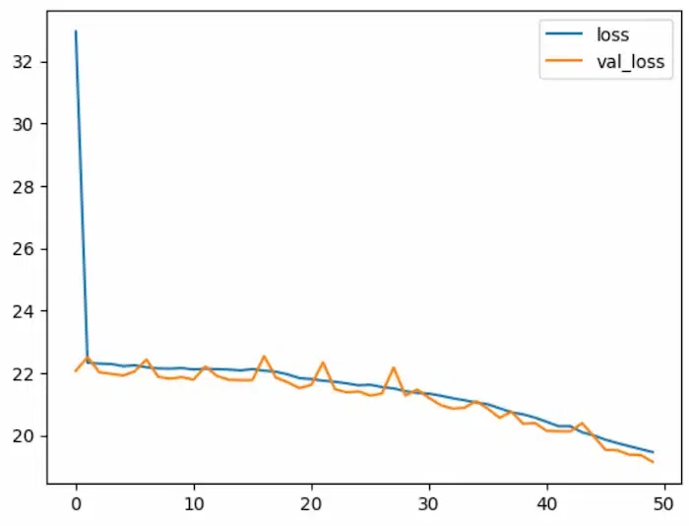
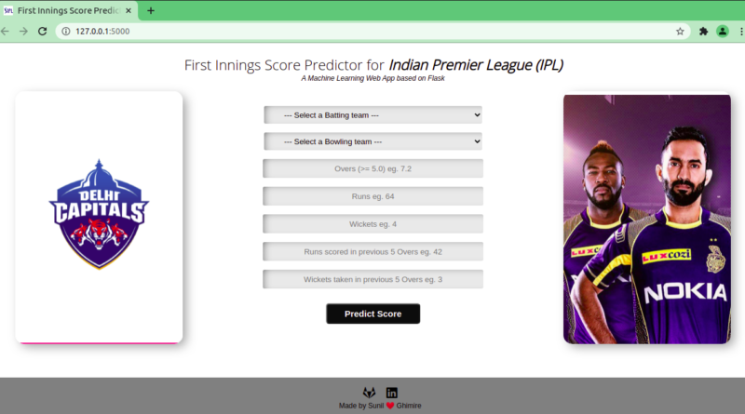
PROJECT TITLE
IPL SCORE PREDICTION USING DEEP LEARNING

Slide 3
AGENDA
This project uses deep learning techniques to predict the IPL match score between two teams beforehand. With the usage of deep learning we can analyze how the players and teams have performed against the opposite team previously and train the model accordingly. Using only machine learning algorithm gives a moderate accuracy therefore we use deep learning which gives much better performance than our previous model and considers the attributes which can give accurate results. The project can provide insights into the dynamics of a match and help anticipate how different factors impact the final score.

Slide 4
PROBLEM STATEMENT
Predicting the total score of IPL cricket matches poses a complex challenge due to the dynamic nature of the game, influenced by factors like team composition, player form, pitch conditions, and match venue. By harnessing the power of advanced neural network architectures, the objective is to provide stakeholders, including fans, analysts, and betting enthusiasts, with reliable insights into the expected outcomes of IPL encounters, enhancing the viewing experience and aiding strategic decision-making.

Slide 5
PROJECT OVERVIEW
The project identifies the use of deep learning in predicting the IPL score where a model is developed which can analyse the historical match datas and predict the score with atmost possible accuracy.This involves data preprocessing, Training the model on the dataset, Defining the neural network model,Evaluating the performance and finally an interactive widget that enables the user to select two teams and predict the score.

Slide 6
WHO ARE THE END USERS?
The IPL score prediction model serves a wide range of users, each with unique needs and interests. Cricket fans benefit from enhanced viewing experiences, as predictions provide additional context and excitement to match outcomes. Fantasy cricket players leverage predictions to strategically assemble their teams, optimizing player selections based on anticipated performances and match dynamics. Media analysts incorporate predictions into their analyses, enriching their content with deeper insights and perspectives for their audience. Team management utilizes predictions to make informed strategic decisions, guiding team composition, batting orders, bowling strategies, and field placements. Additionally, broadcasters and advertisers leverage predictions to enhance audience engagement during IPL broadcasts, offering real-time insights.

Slide 7
SOLUTION AND ITS VALUE PROPOSITION
The proposed solution is an automated IPL Score Prediction based on Neural networks and the deep learning technology. It has various features that enable the users to benefit from the system.
1.Real-time Score Predictions: Integration of the predictive models into a user-friendly interface or application to provide real-time score predictions for upcoming IPL matches, allowing users to access insights and make informed decisions.
2.Community Engagement: Engagement with the cricket community, stakeholders, and end users to gather feedback, address concerns, and incorporate user preferences into the development and deployment of the predictive models, ensuring relevance and usability.
3.Collaboration Opportunities: Exploration of collaboration opportunities with cricket leagues, teams, broadcasters, fantasy platforms, and betting agencies to integrate score predictions into their platforms or services, thereby expanding the reach and impact of the predictive models.
4.Scalability: Commitment to continuous improvement and refinement of the predictive models by incorporating new data.

Slide 8
THE WOW IN SOLUTION
The wow factor of an IPL score prediction model lies in its ability to take the chaos and uncertainty of cricket and use data analysis to generate probabilities for what might unfold. Imagine knowing before the match if it's likely to be a high-scoring thriller or a low-scoring nail-biter. This can heighten the viewing experience for fans by adding an extra layer of anticipation and intrigue.

Slide 9
MODELLING
IPL score prediction model use deep learning techniques to analyze past data like team stats and win/loss records. This data is cleaned and fed into the model, which learns to identify patterns that influence scores. The model is trained with historical cricket match data of the previous years and then tested and refined before being used to predict scores for future matches.The predicted score are with atmost possible accuracy. Remember, these are predictions, not crystal balls – cricket's full of surprises!

Slide 10
RESULTS
The deep learning model successfully identified patterns in historical data to predict IPL match scores. While the exact score remains elusive, this project provides a valuable tool for fans and analysts to understand factors influencing the game.The model evaluation shows that the model works with high accuracy and thus giving its users a better experience.The model has proved that it has the potential to predict the scores of the ever-exciting IPL cricket matches and giving various insights about the match to the cricket fans,media professionals and broadcasters.

